Slide 1
Job Recommendation System
Aakanchhya Sigdel (8097/072)
Subesh Bhandari (8136/072)
Tashi Lama (8141/072)

Slide 2
Introduction
Job Recommendation System
Job seeker subsystem
Job provider subsystem

Slide 3
Problem definition
For Job Seekers
Searching jobs with matching criteria
No response from recruiting company
For Job Providers
Finding right job candidate
Surfing through numerous CVs.

Slide 4
Objectives
Recommend jobs
Enable job seekers to search and apply for jobs
Enable job seekers to take skill tests.
Enable job providers to post jobs.
Enable job providers to hire job applicants.

Slide 5
Scope of the project
For Job Seekers
get jobs recommended
search and apply for jobs
view activity on dashboard
For Job Providers
post jobs
view job post report

Slide 6
Limitations
Fails to track every job seeker’s and job provider’s information.
Fails to recommend jobs to user not logged in.
Fails to modify testing process in system.

Slide 7
Literature Review
Applying Different Classification Techniques in Reciprocal Job Recommender system for considering Job Candidate Preference
Combining content-based and collaborative filtering for job recommendation system: A cost-sensitive Statistical Relational Learning approach

Slide 8
Literature Review
Dynamic User Profile-Based Job Recommender System

Slide 9
Related Study
Upwork
Mero Job

Slide 10
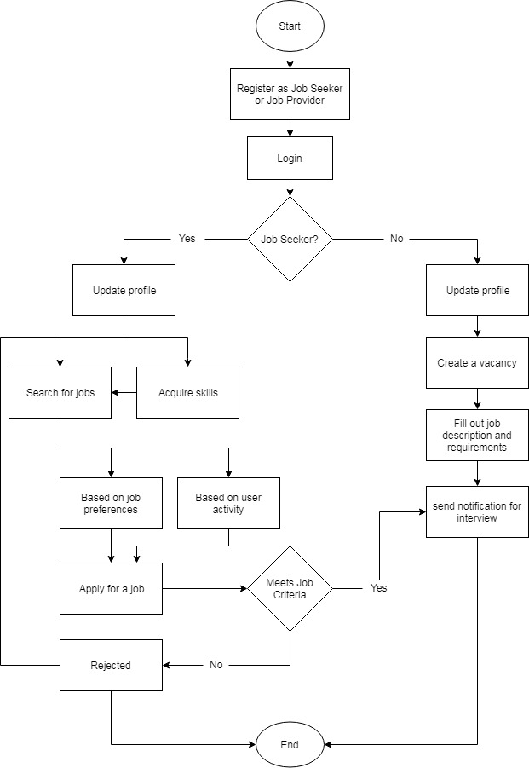
Flow Chart

Slide 11
Methodology
Recommendation System
User based Collaborative Filtering
Item based Collaborative Filtering
Pearson’s Correlation
Candidate Evaluation System

Slide 12
System Development Process
Agile Kanban
Increase Productivity
Increase Collaboration
Sustain Development of the process
Github

Slide 13
System Requirement
Functional Requirement
Job seekers
Job providers
Use-Case diagram

Slide 14
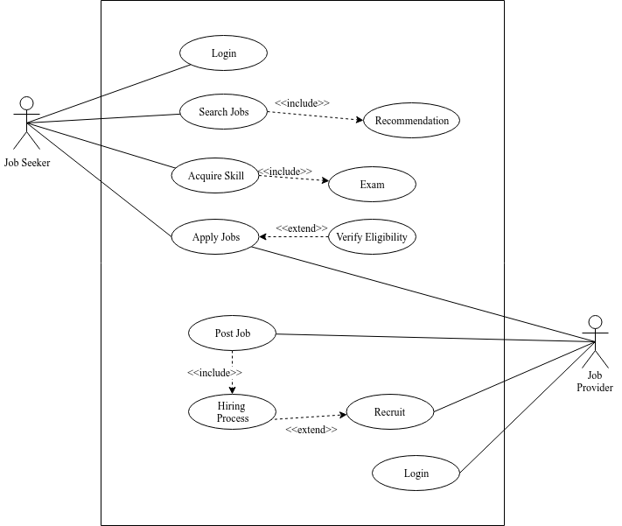
Use case diagram

Slide 15
System Requirement
Non-functional Requirements
User friendly
Responsive
Fast
Secure
Support all browsers

Slide 16
Feasibility Study
Schedule Feasibility
Technical Feasibility
Operational Feasibility
Economic Feasibility

Slide 17
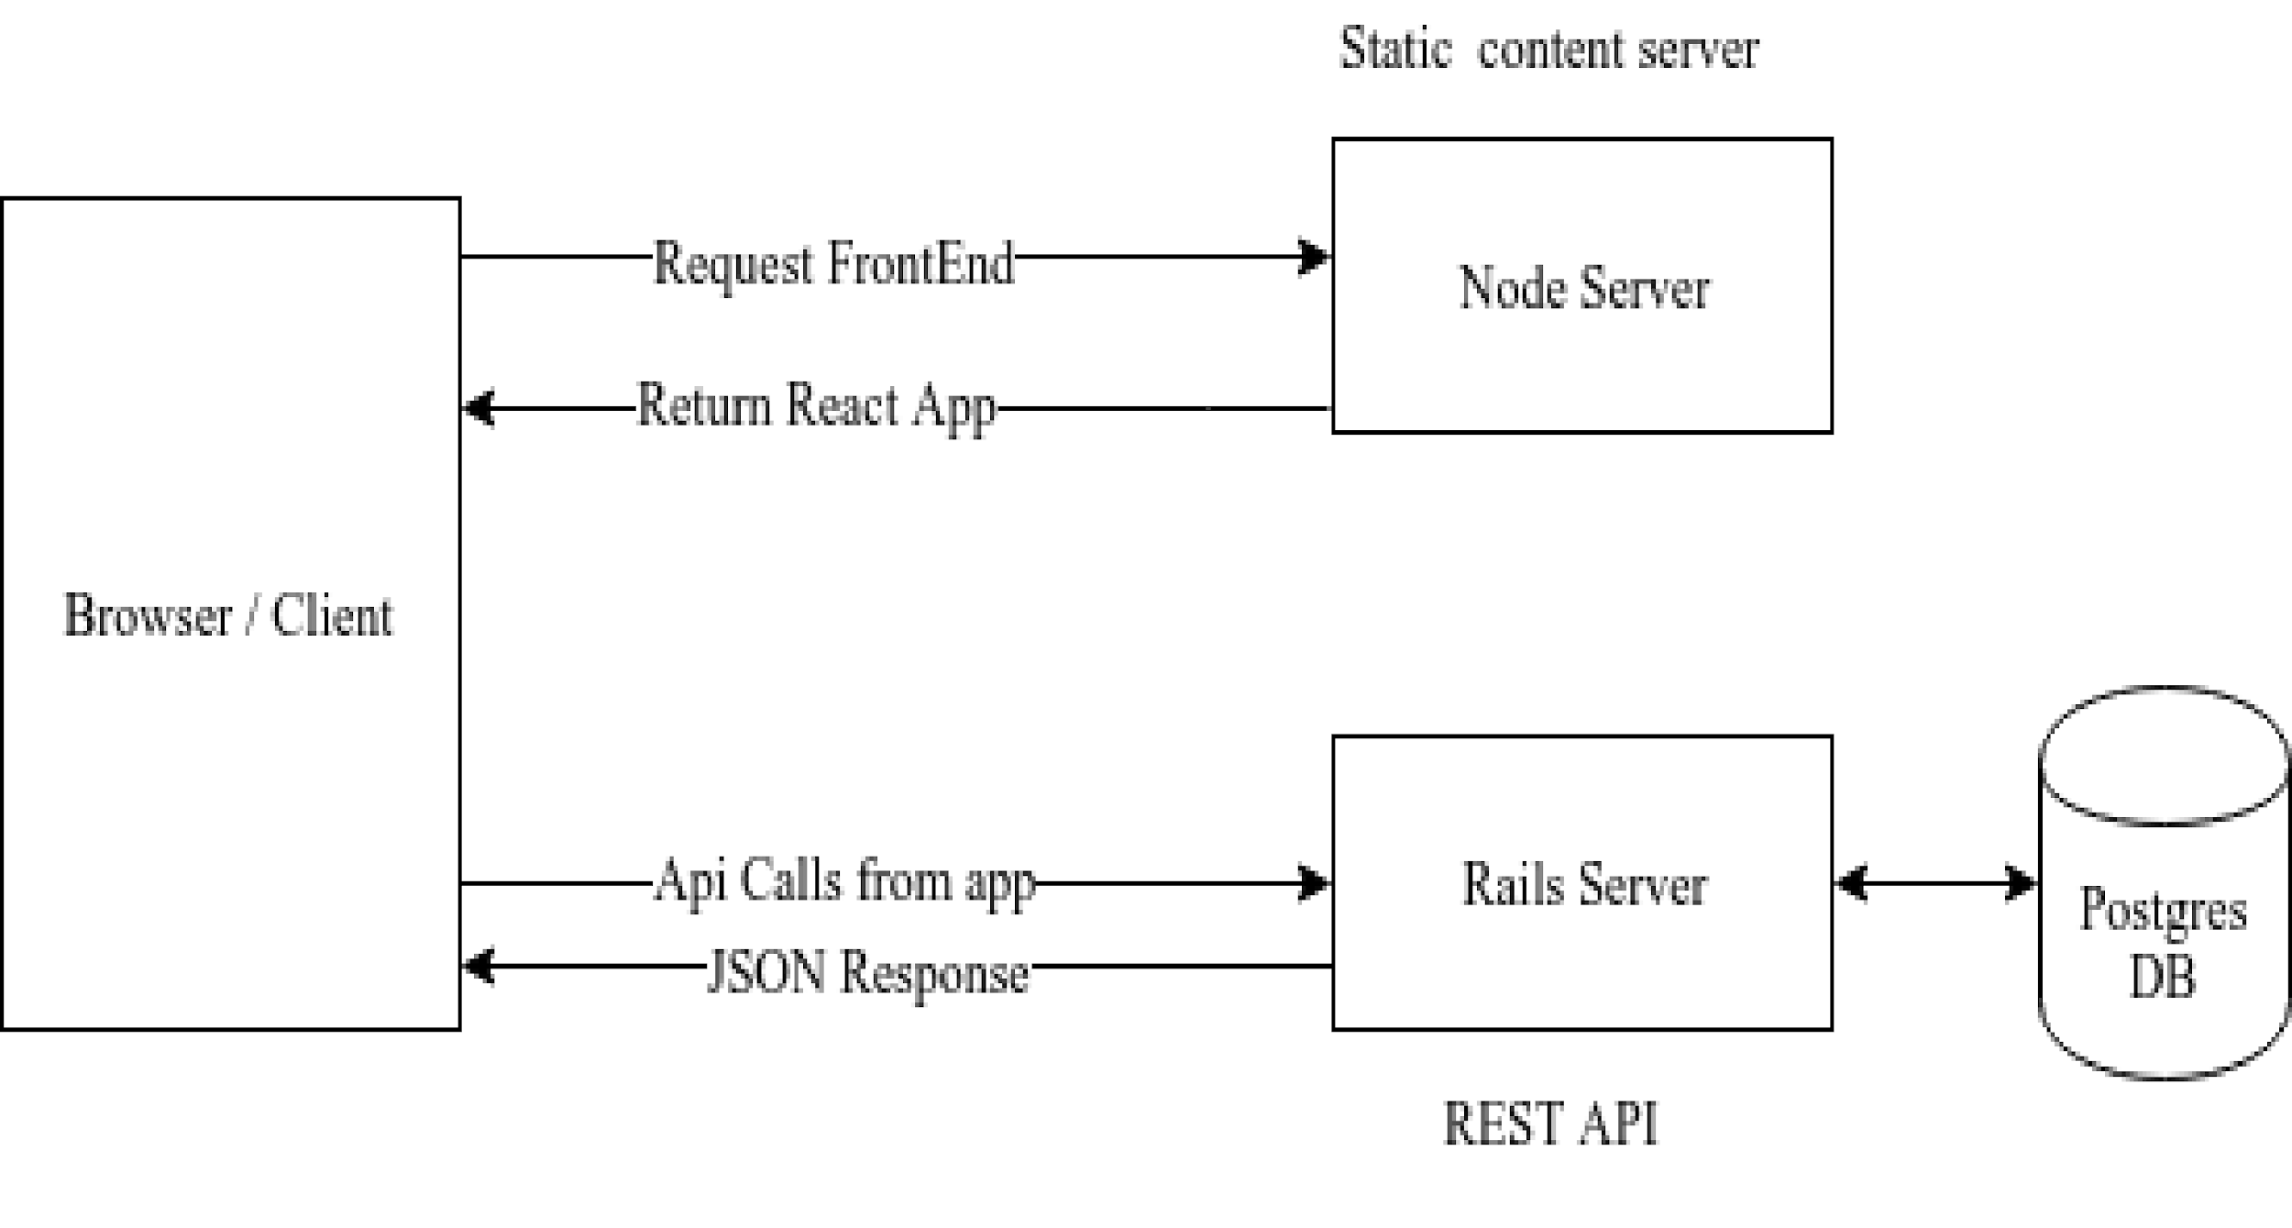
System Architecture

Slide 18
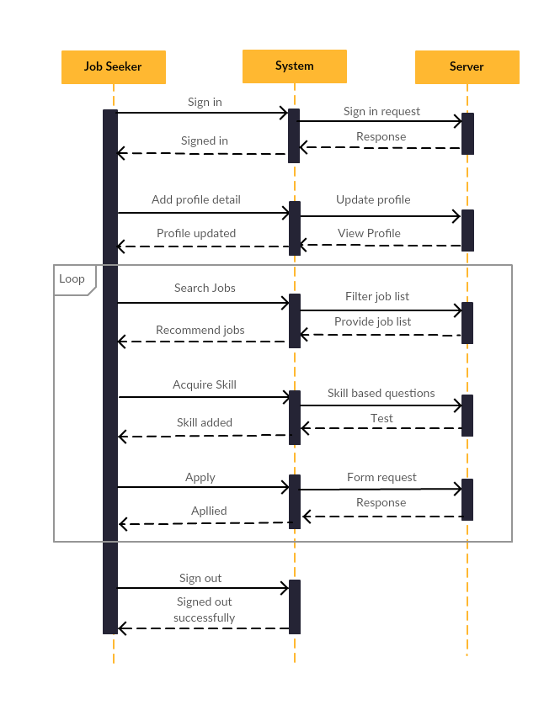
Sequence Diagram

Slide 19
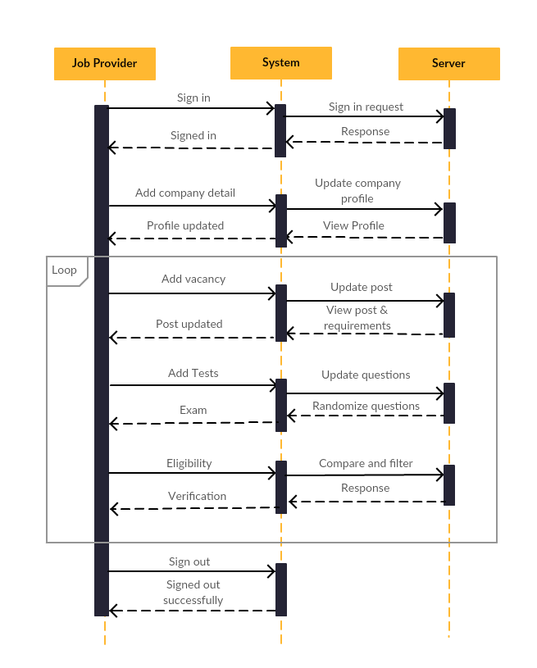
Sequence Diagram

Slide 20
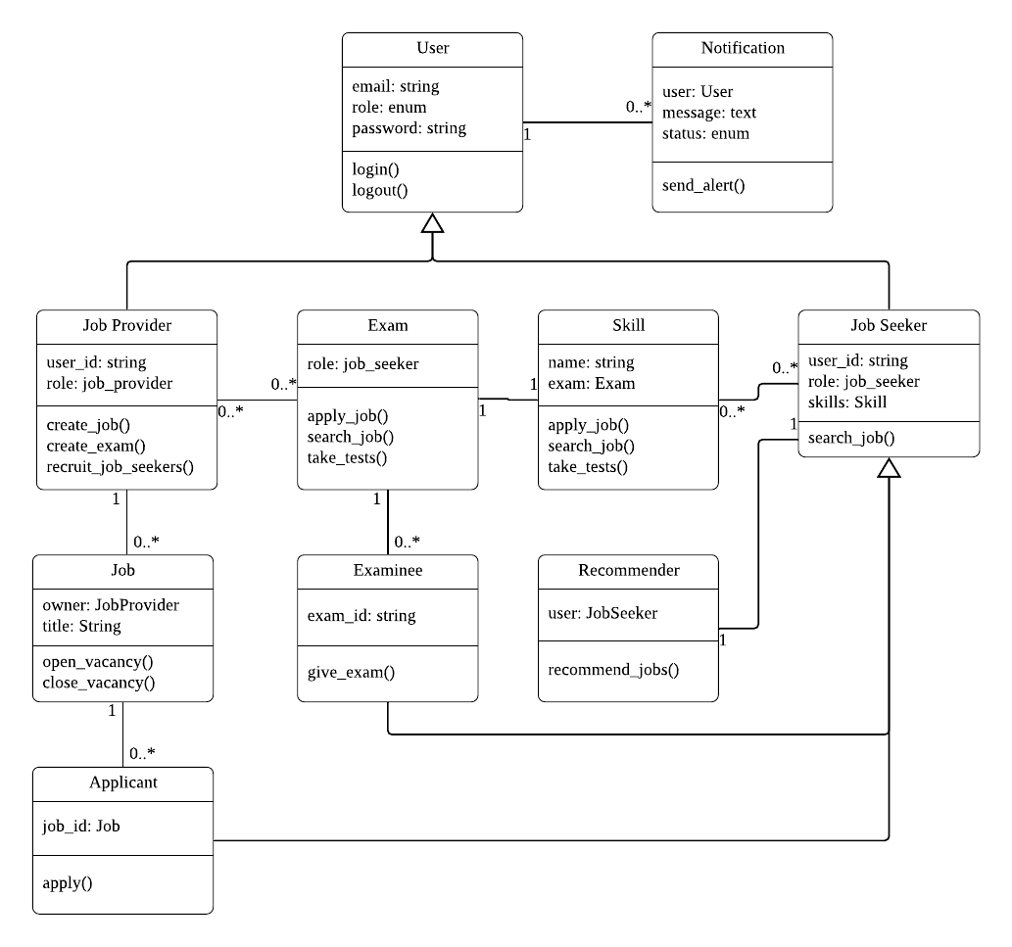
Class Diagram

Slide 21
Implementation
Languages
React JS
Ruby on Rails
Operating System
Windows
Ubuntu

Slide 22
Implementation
Development Tools
Github
VS Code
Postman

Slide 23
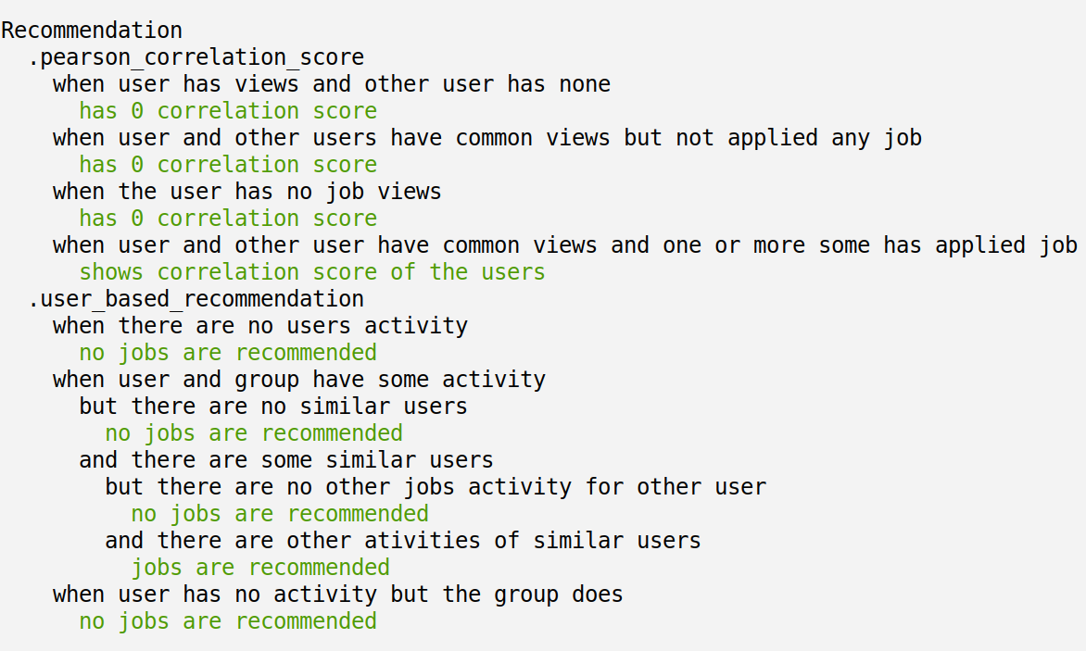
Testing
Unit Testing

Slide 24
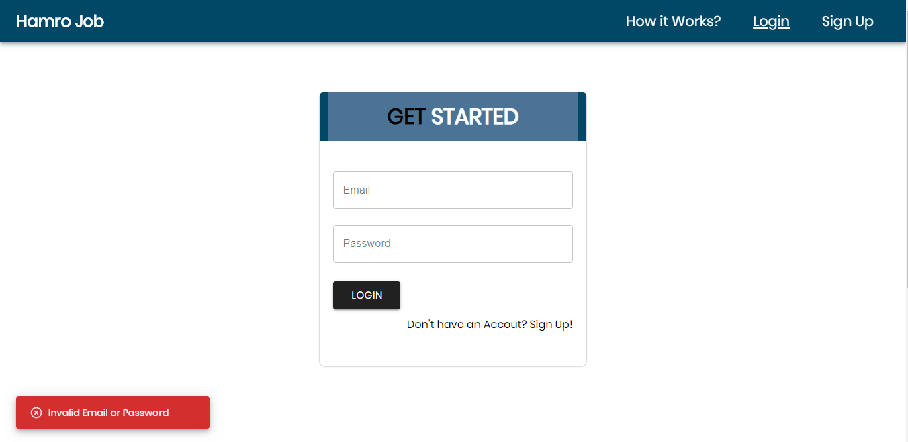
Testing
Integrated Testing
Login component testing
Test case: empty input fields

Slide 25
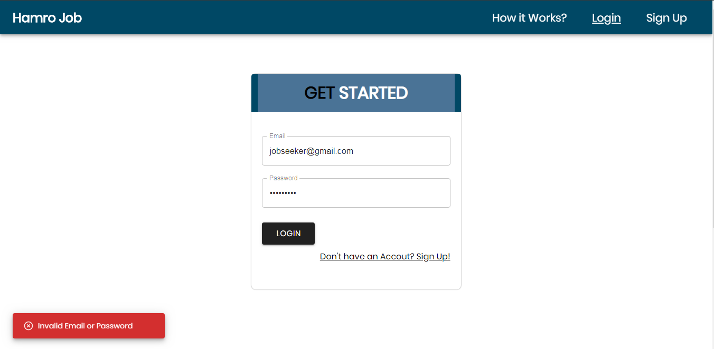
Testing
Test case: invalid credentials

Slide 26
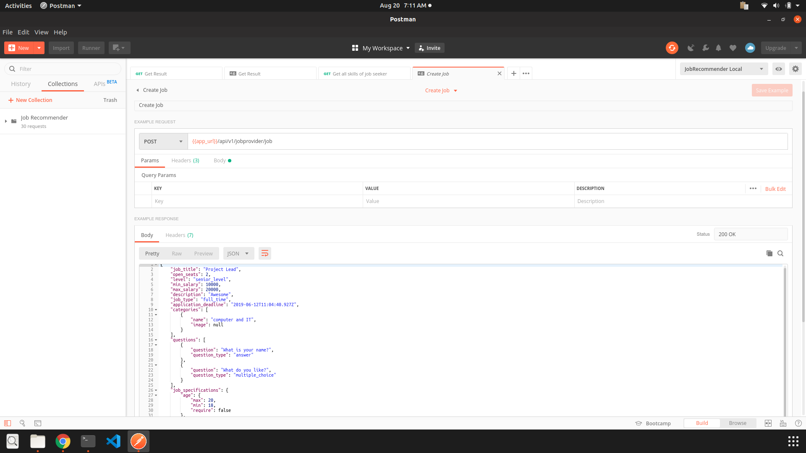
Testing
API testing

Slide 27
Testing
System Testing
S.N. | Test Case | Expected | Remarks
1. | Launch site | Loads logo and pages | As expected
2. | View job seeker profile | Show basic information, work experience, educational qualifications | As expected
3. | View job provider profile | Show basic information | As expected
4. | Update profile | Receive Notification | As expected
5. | Apply or post job | Receive Notification | As expected

Slide 28
Testing
6. | Update job information and specification | Receive Notification | As expected
7. | View job seeker home page | Load top jobs, latest jobs and recommended jobs | As expected
8. | Search jobs | Enable job search according to job category, type and level | As expected
9. | Session Functionality | Create & destroy session as user login & logout respectively | As expected
10. | Launch site in major browsers | Load pages and content properly | As expected
11. | Launch site in different platforms | Load pages and content properly | As expected
12. | Skill Test | Enable user to take tests on different working fields | As expected

Slide 29
Result
Job seekers can search and apply for jobs.
Jobs are recommended to job seekers.
Job providers can post jobs and hire job applicants.

Slide 30
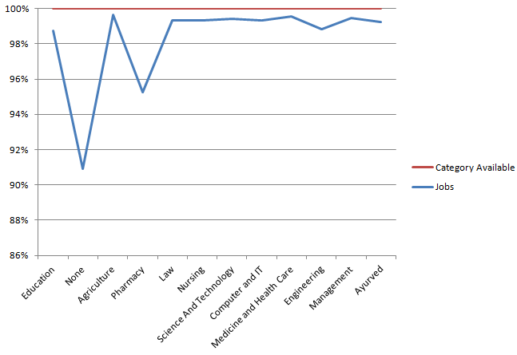
Analysis
Stats of Jobs per category

Slide 31
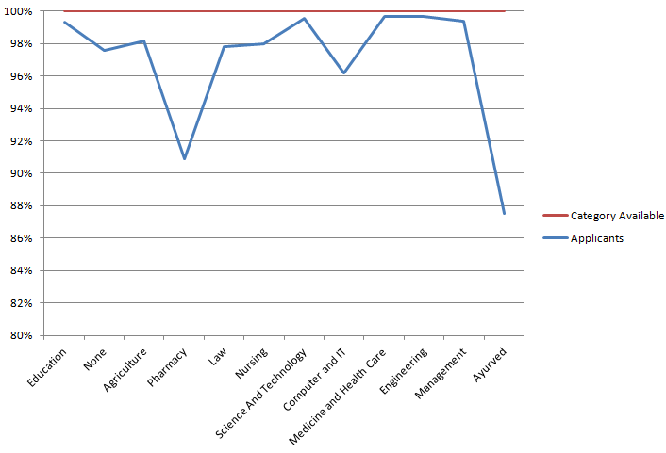
Analysis
Stats of Applicants per category

Slide 32
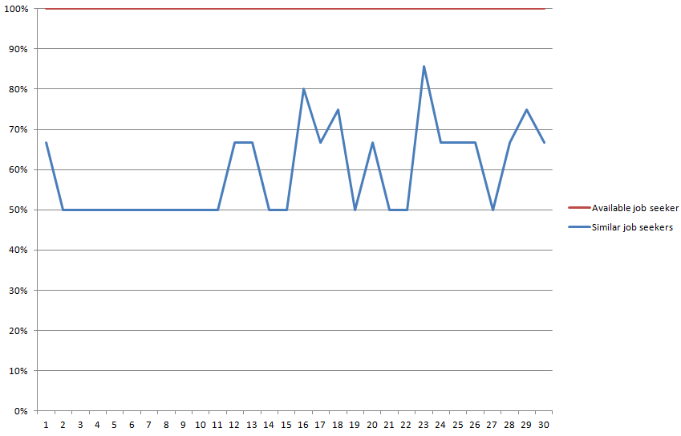
Analysis
Stats of Similar users for test data

Slide 33
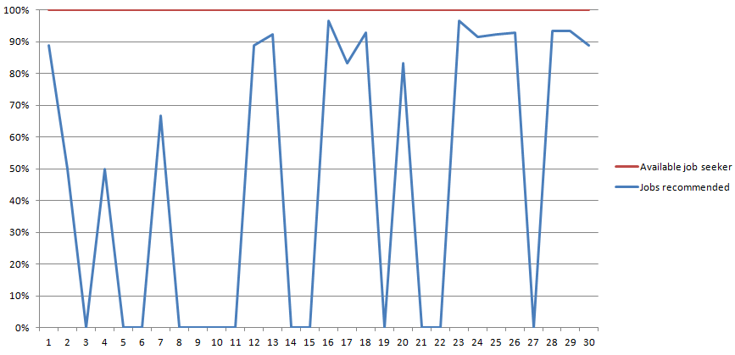
Analysis
Stats of Job Recommendation for test users

Slide 34
Conclusion
Fulfills all the objectives
Provides job recommendation to job seekers
Provides job creation and applicants
Provides easy user interface for both users

Slide 35
Recommendations
Real-time online interview
Update profile dynamically
Learning materials, resources

Slide 36
DEMO
https://final-project-trinity.netlify.com

Slide 37
THANK YOU!

